Slide 1
INTRODUCTION TO
ALGORITHMS
FOURTH EDITION

Slide 2
LECTURE NOTES FOR CHAPTER 25
Matchings in Bipartite Graphs

Slide 3
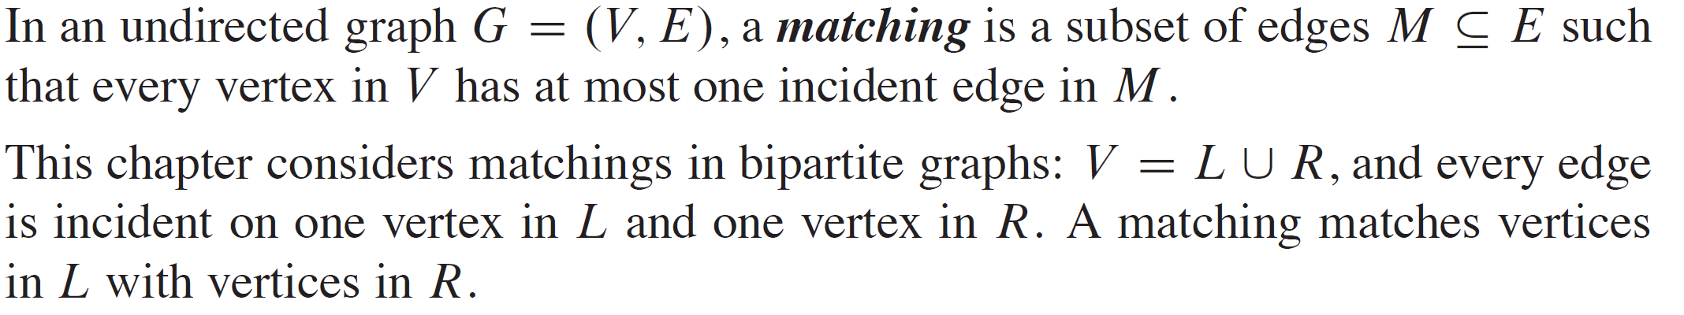
CHAPTER 25 OVERVIEW

Slide 4
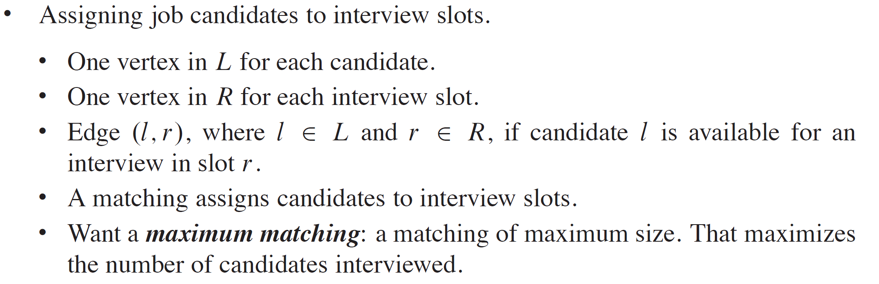
EXAMPLE APPLICATIONS OF MATCHING

Slide 5
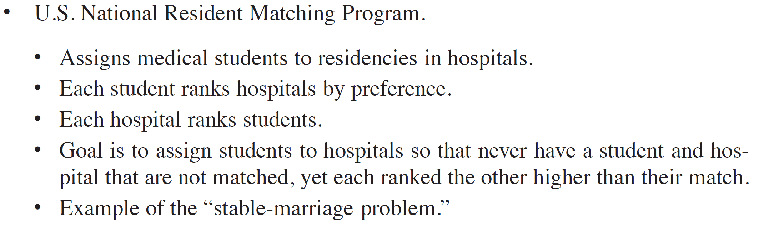
EXAMPLE APPLICATIONS OF MATCHING (continued)

Slide 6
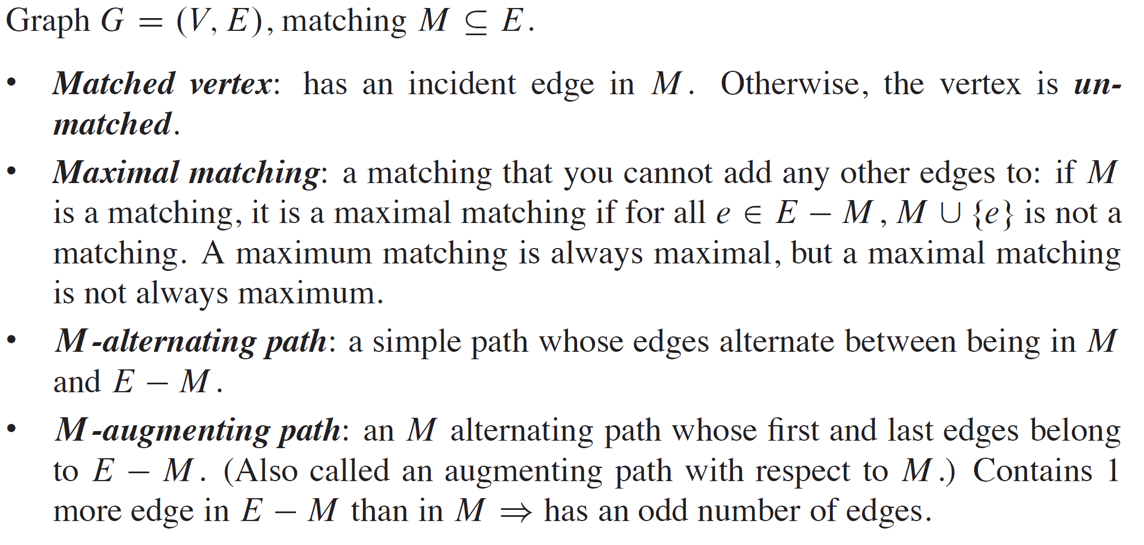
MAXIMUM MATCHING IN BIPARTITE GRAPHS

Slide 7
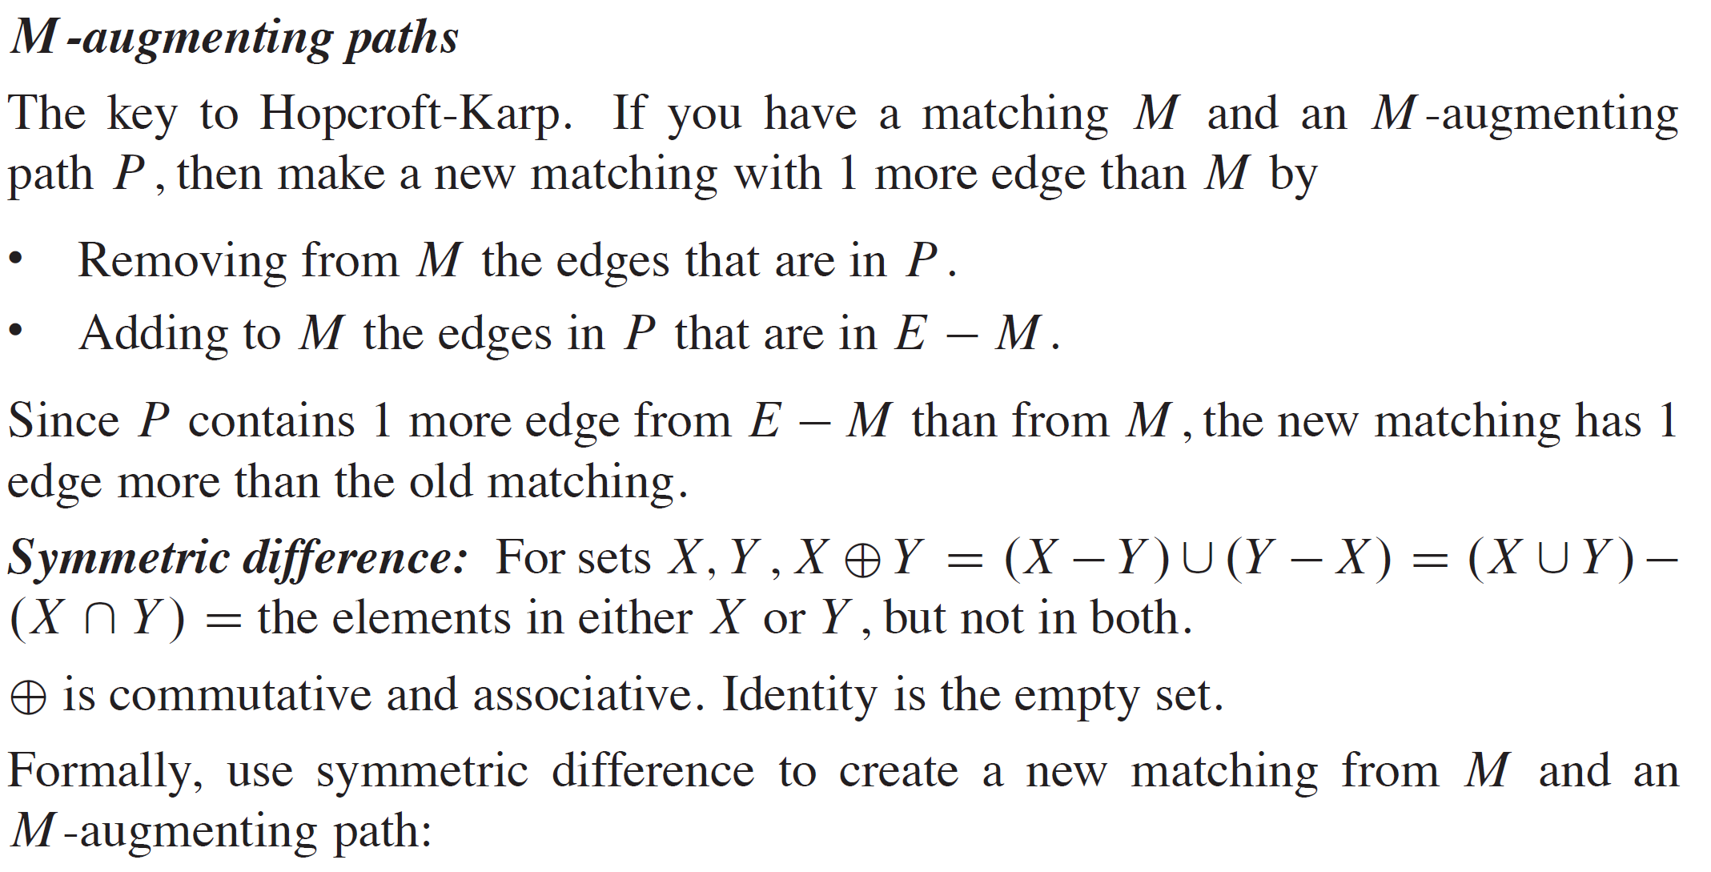
MAXIMUM MATCHING IN BIPARTITE GRAPHS (continued)

Slide 8
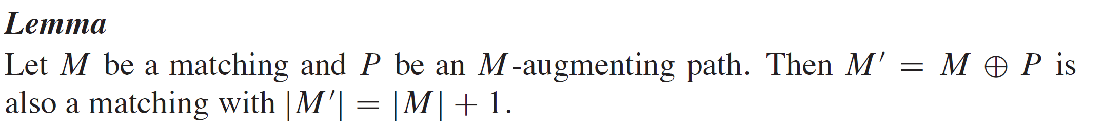
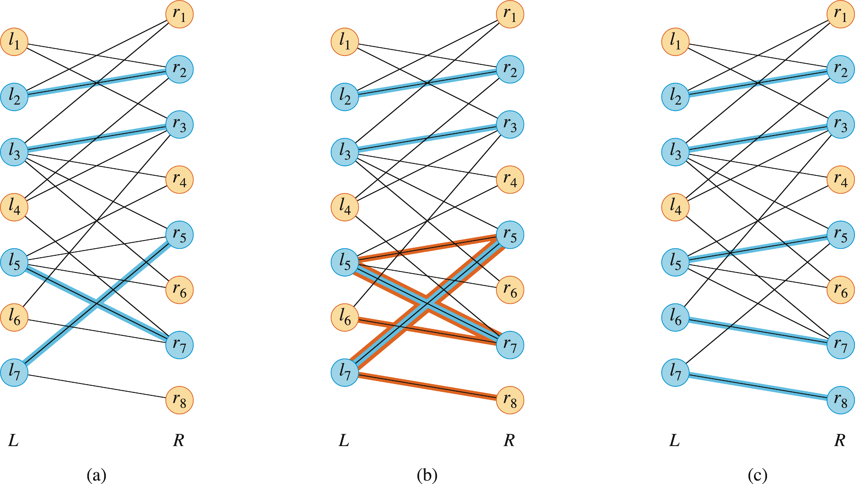
MAXIMUM MATCHING IN BIPARTITE GRAPHS (continued)

Slide 9
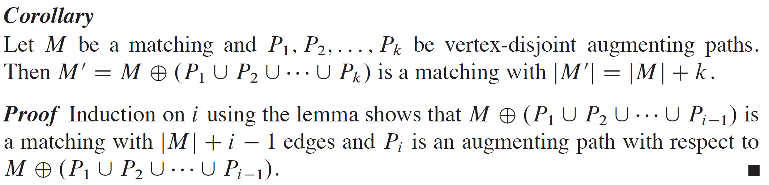
MAXIMUM MATCHING IN BIPARTITE GRAPHS (continued)

Slide 10
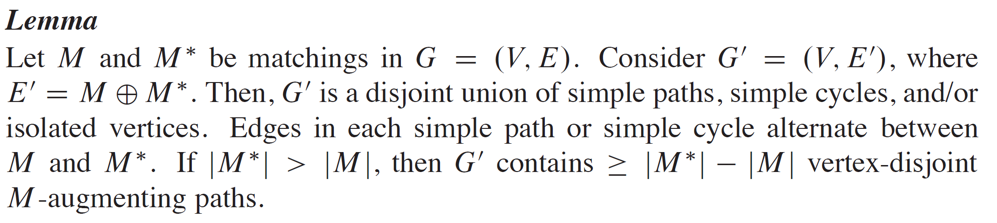
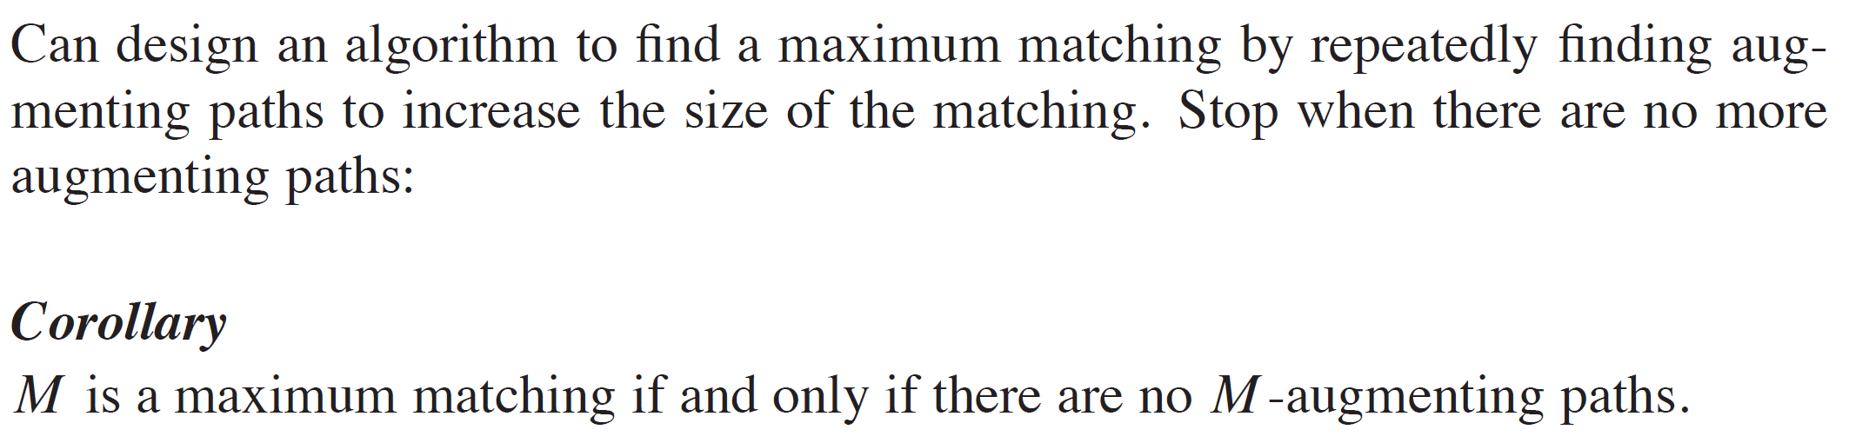
MAXIMUM MATCHING IN BIPARTITE GRAPHS (continued)

Slide 11
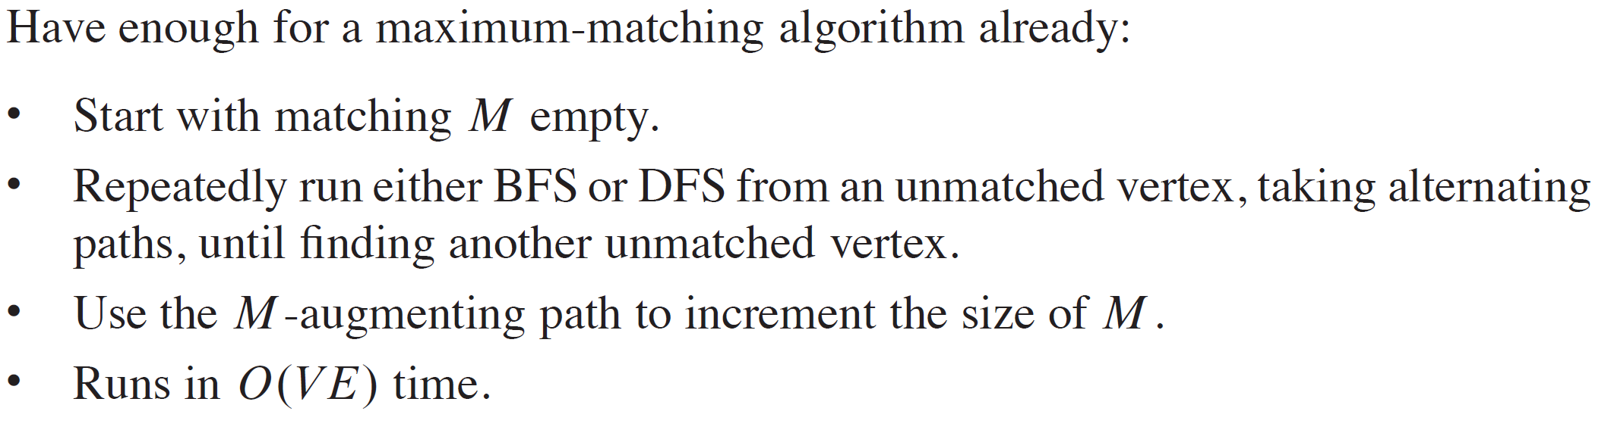
MAXIMUM MATCHING IN BIPARTITE GRAPHS (continued)

Slide 12
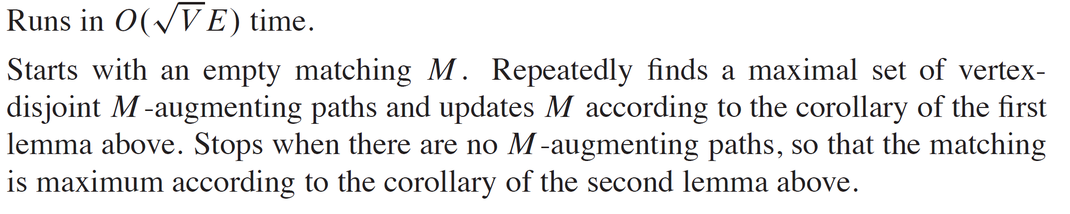
HOPCROFT-KARP ALGORITHM

Slide 13
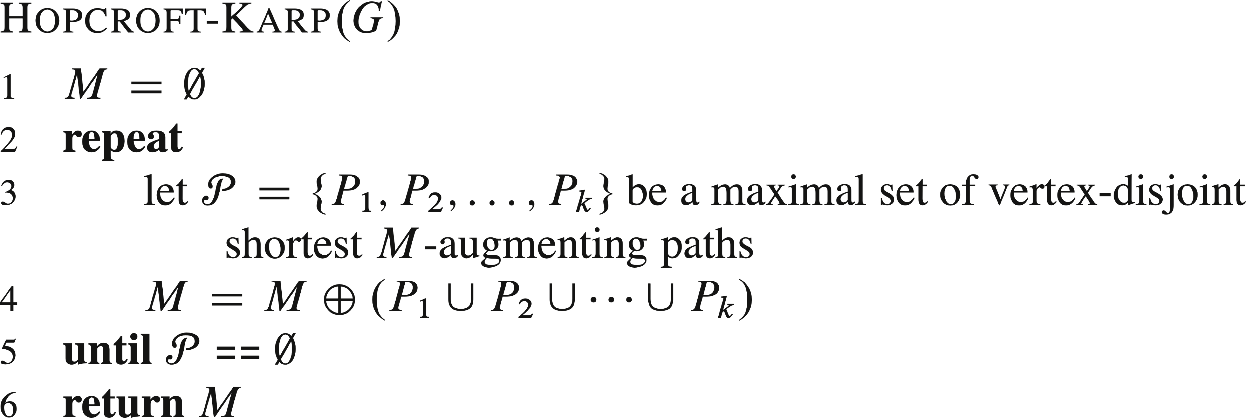
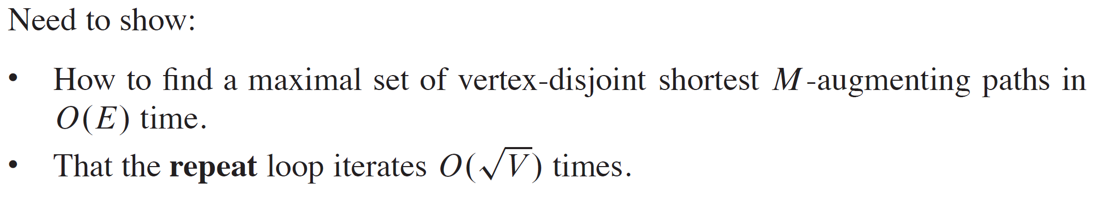
HOPCROFT-KARP ALGORITHM (continued)

Slide 14
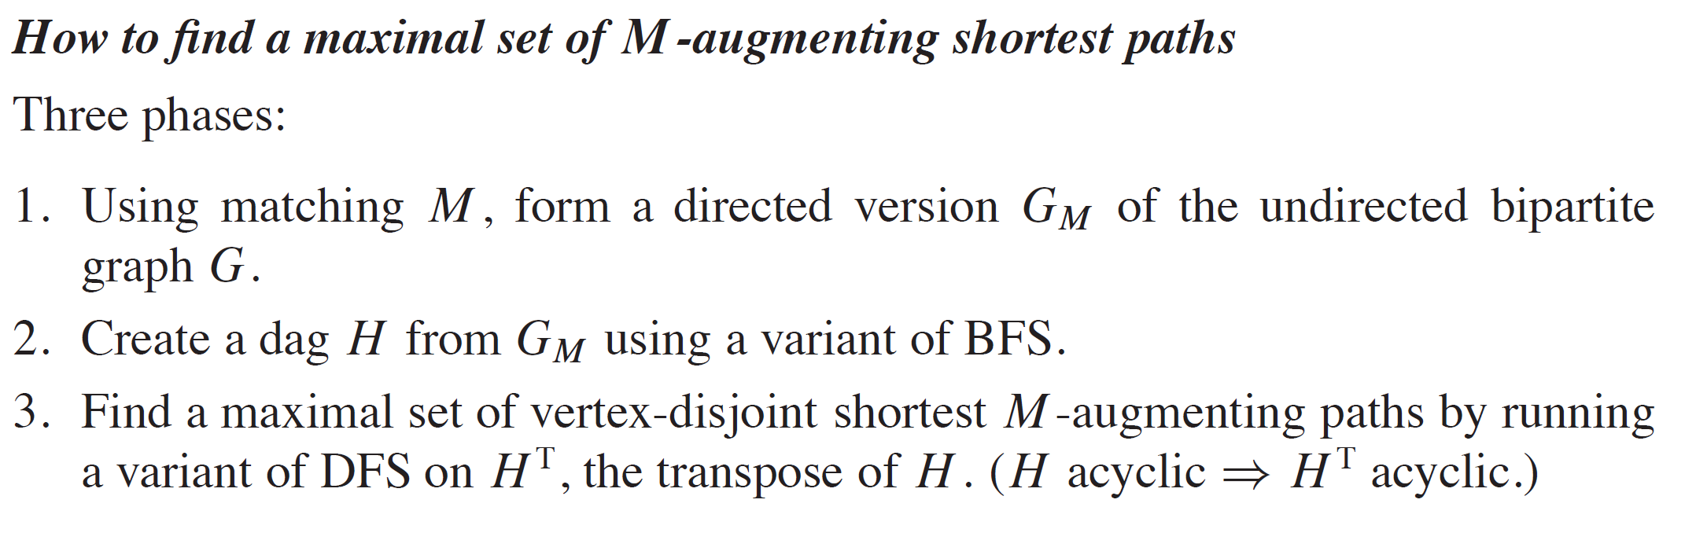
HOW TO FIND A MAXIMAL SET

Slide 15
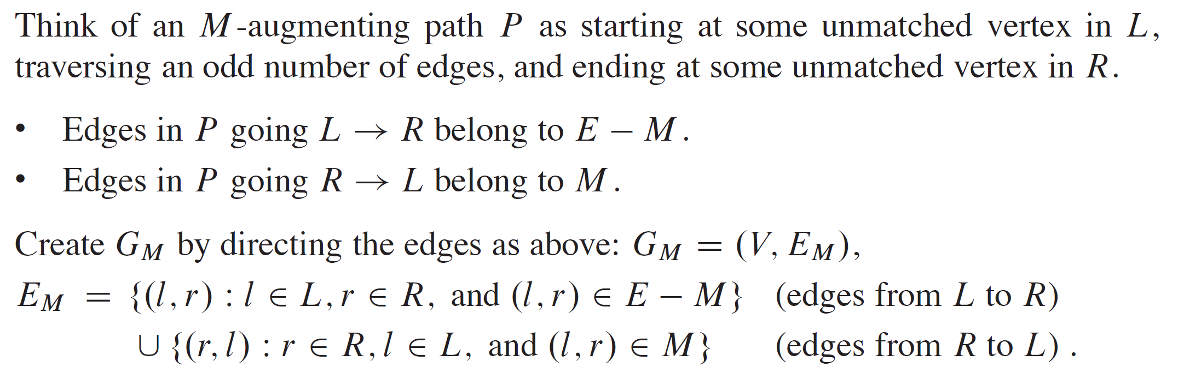
CREATING G_{M}

Slide 16
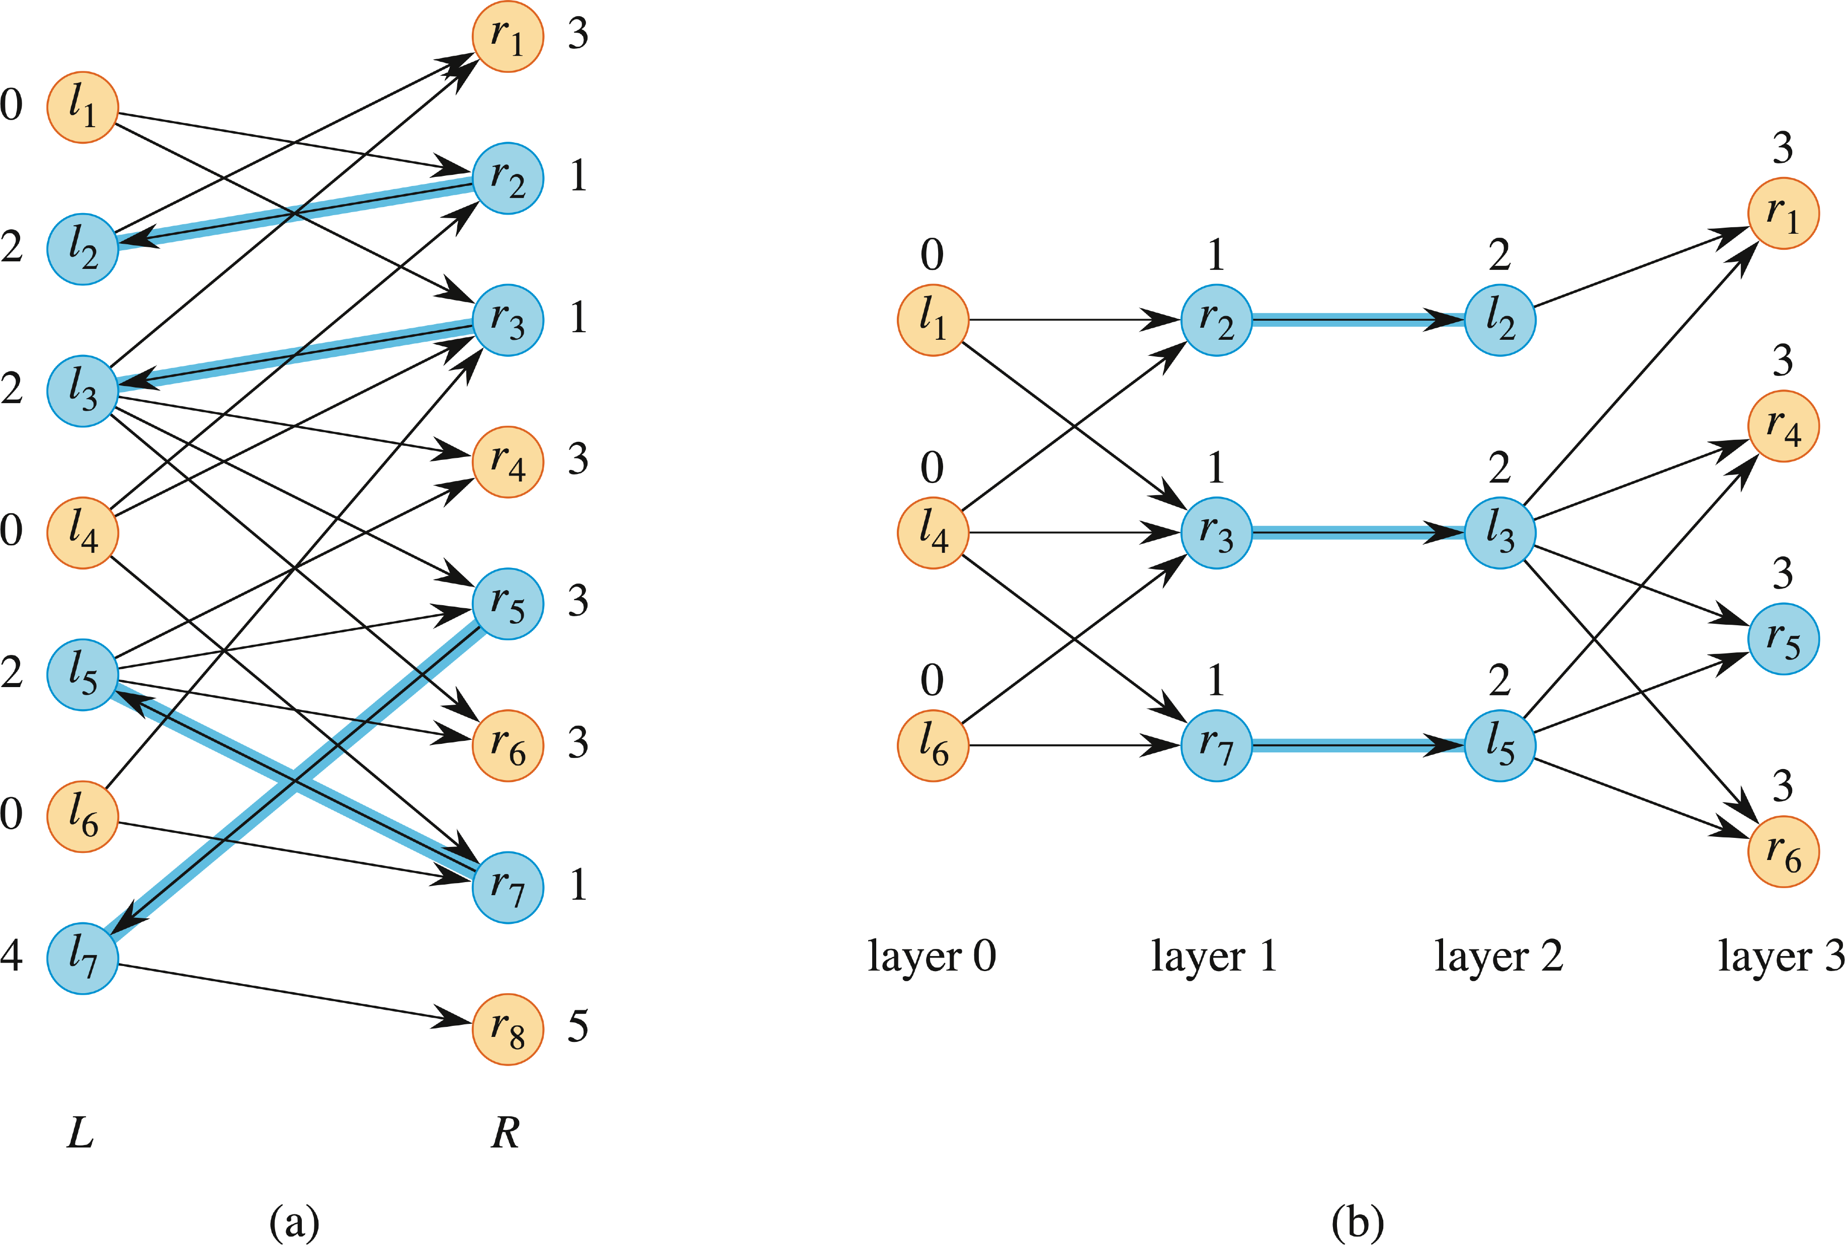
EXAMPLE

Slide 17
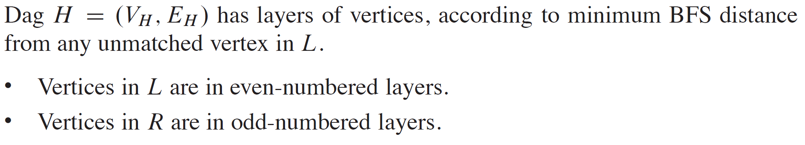
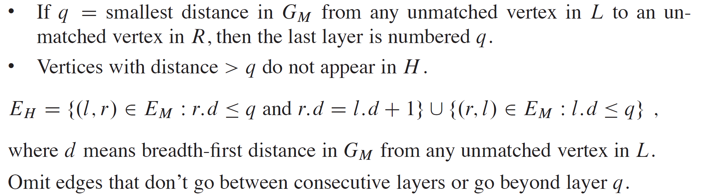
CREATING H

Slide 18
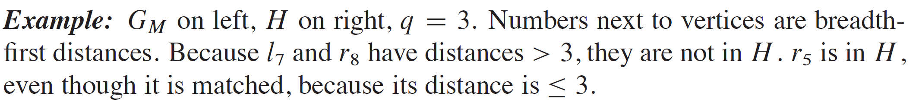

EXAMPLE

Slide 19
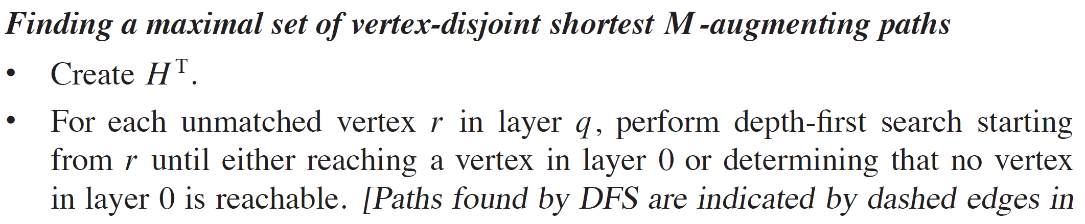
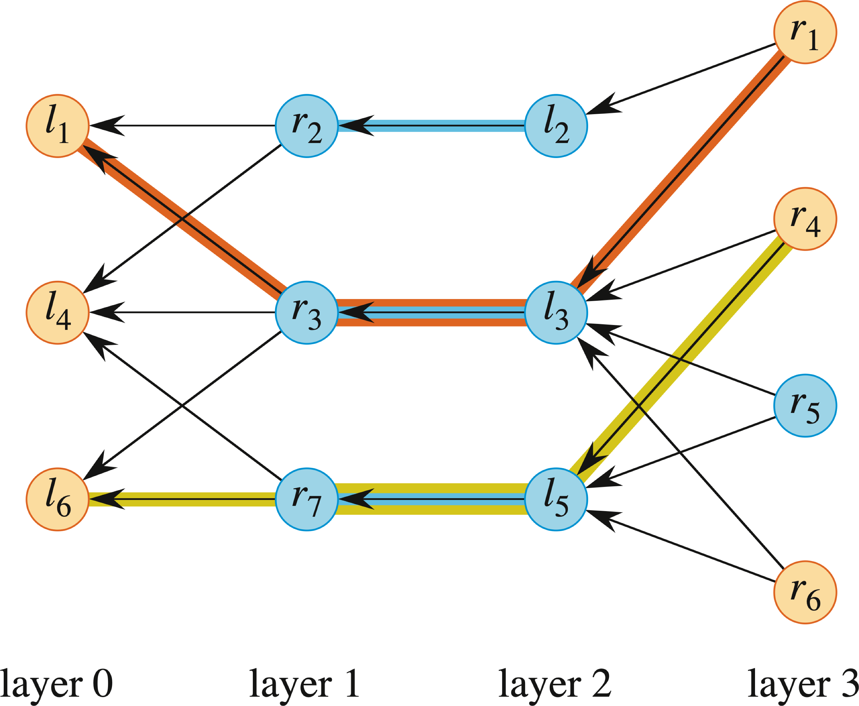
FINDING A MAXIMAL SET

Slide 20
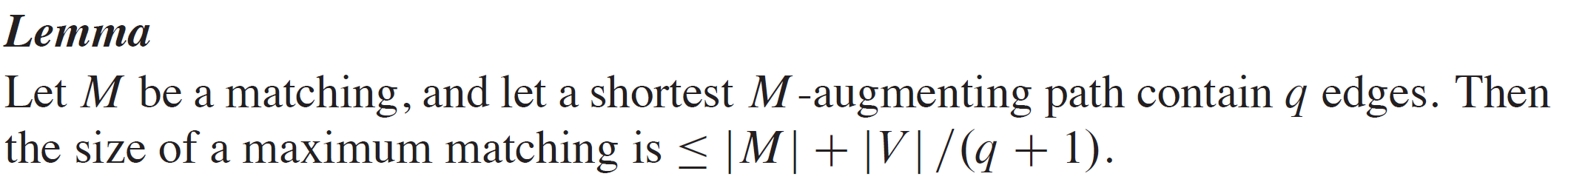
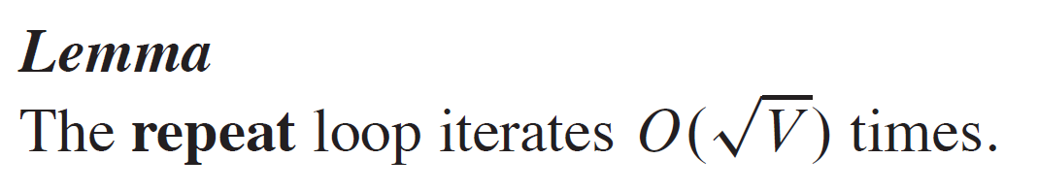
BOUNDING THE ITERATIONS OF THE REPEAT LOOP
Full proof in textbook.

Slide 21
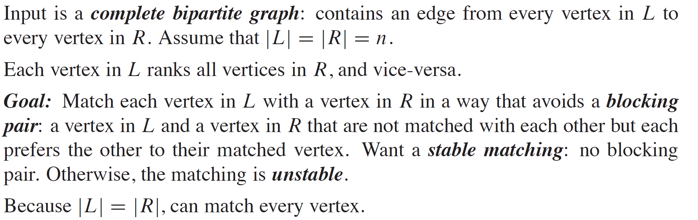
STABLE-MARRIAGE PROBLEM

Slide 22
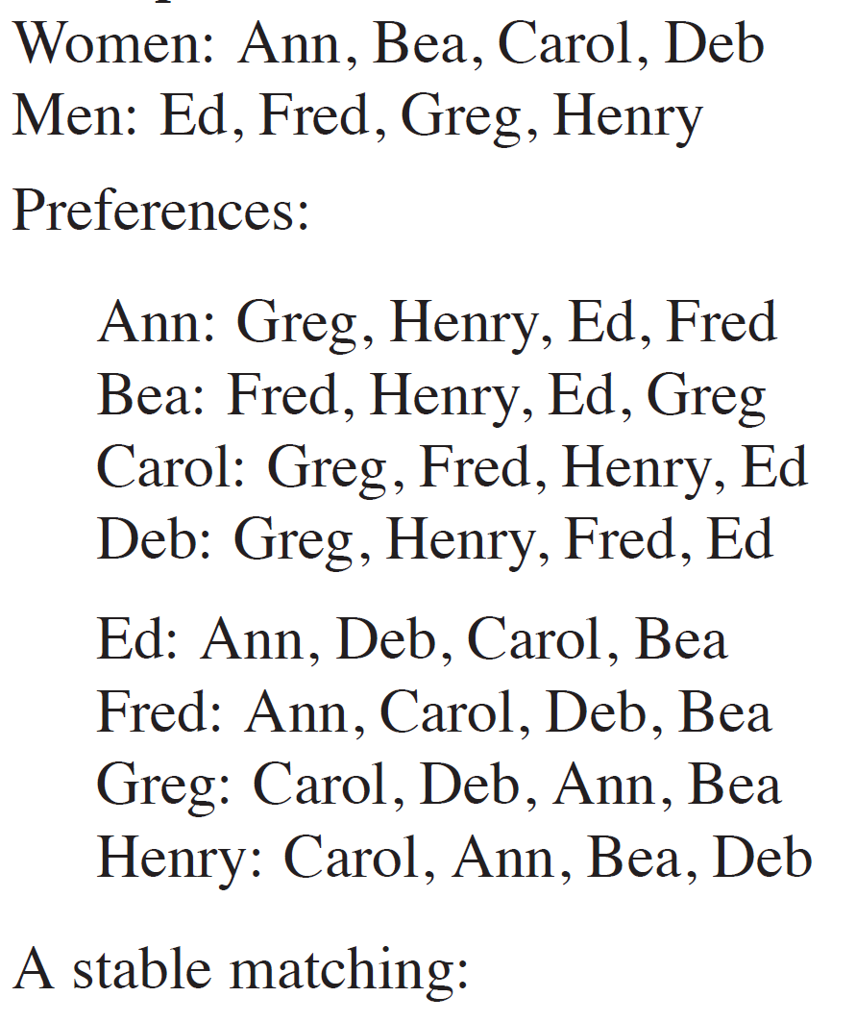
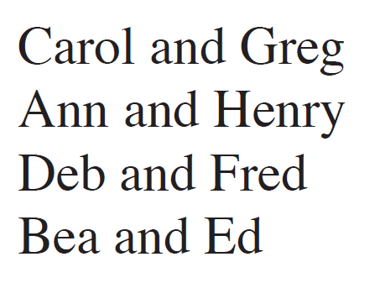
EXAMPLE

Slide 23
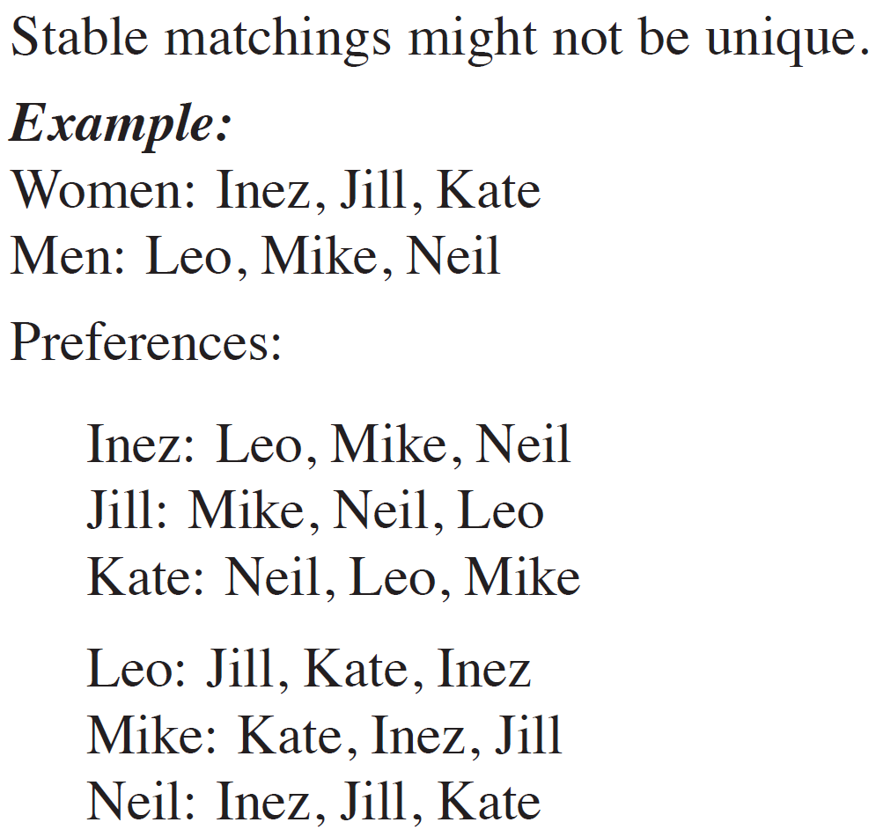
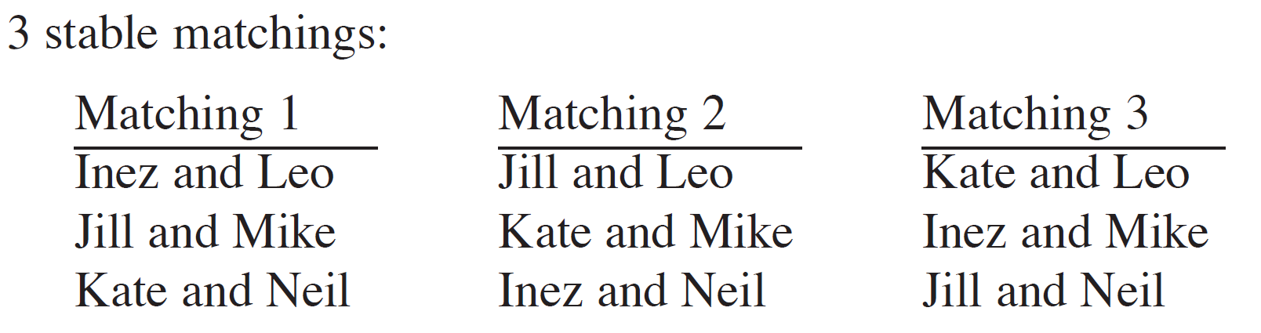
EXAMPLE (continued)

Slide 24
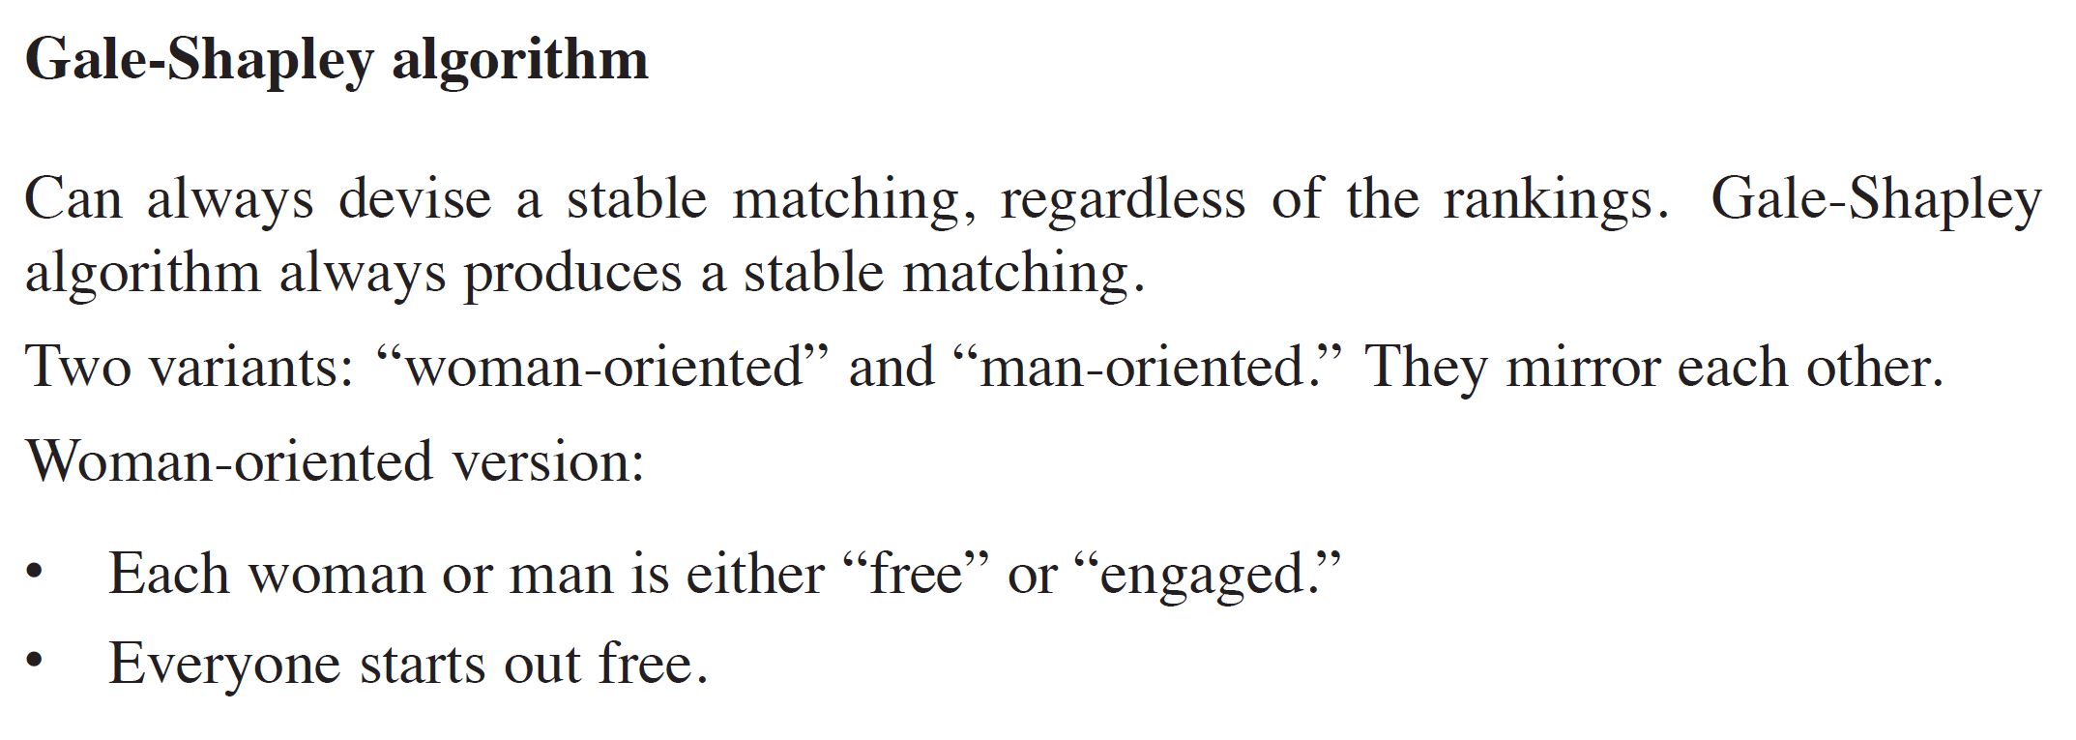
GALE-SHAPLEY ALGORITHM

Slide 25
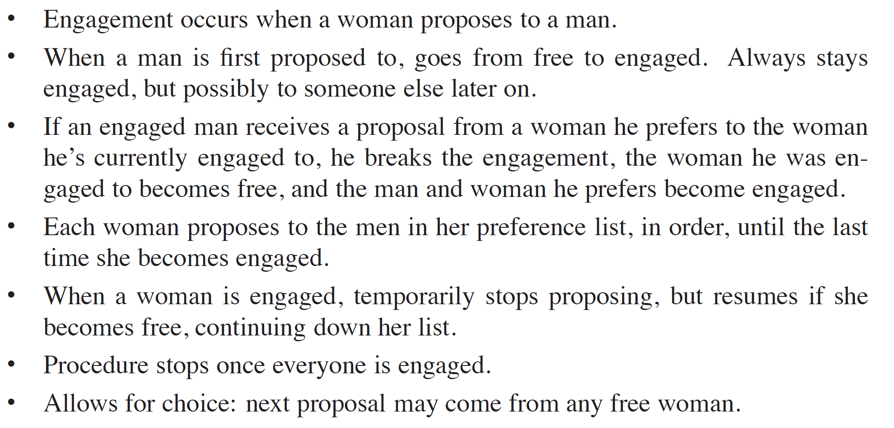
GALE-SHAPLEY ALGORITHM (continued)

Slide 26
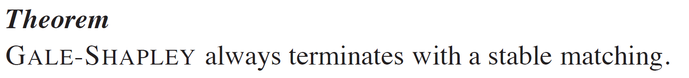
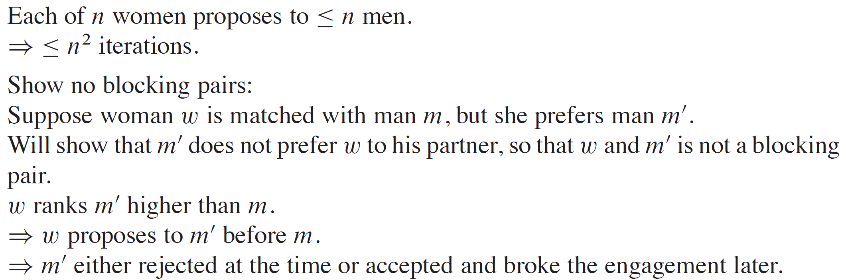
PROOF OF GALE-SHAPELY ALGORITHM

Slide 27
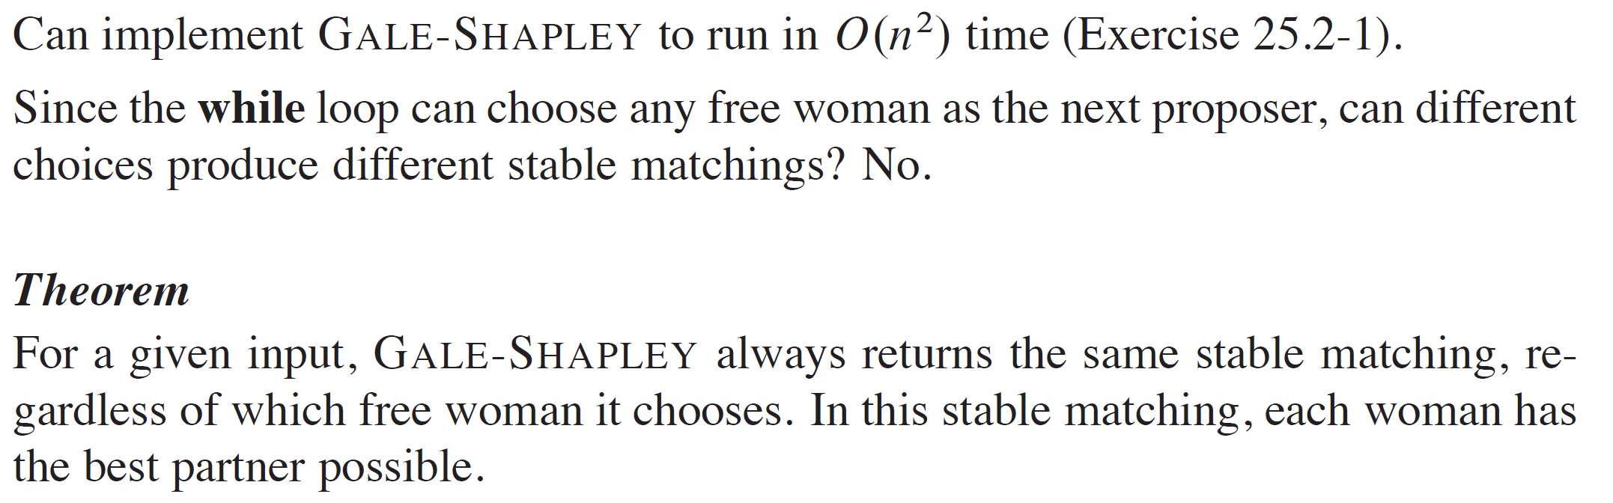
PROOF OF GALE-SHAPELY ALGORITHM (continued)

Slide 28
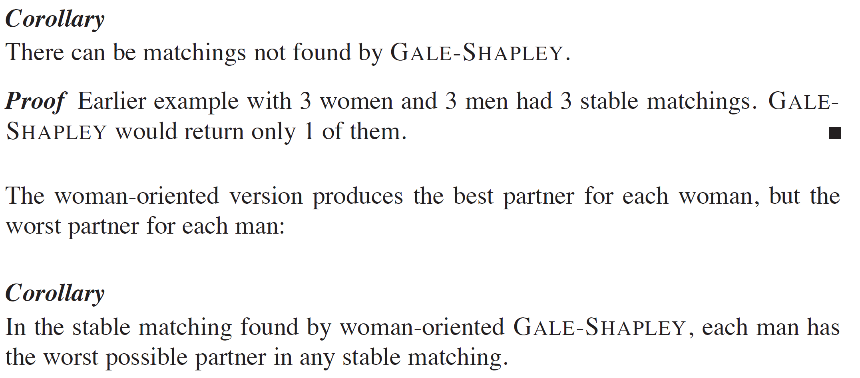
PROOF OF GALE-SHAPELY ALGORITHM (continued)

Slide 29
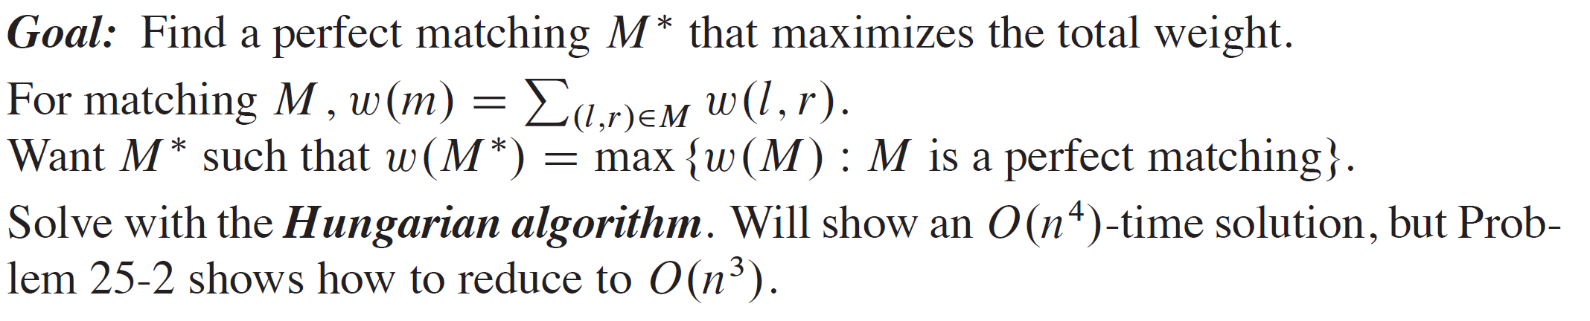
ASSIGNMENT PROBLEM

Slide 30
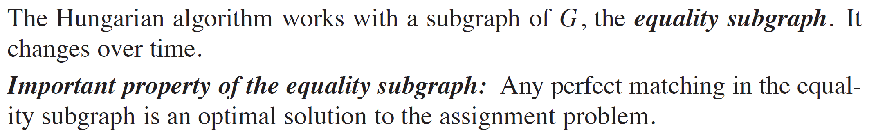
EQUALITY SUBGRAPH

Slide 31
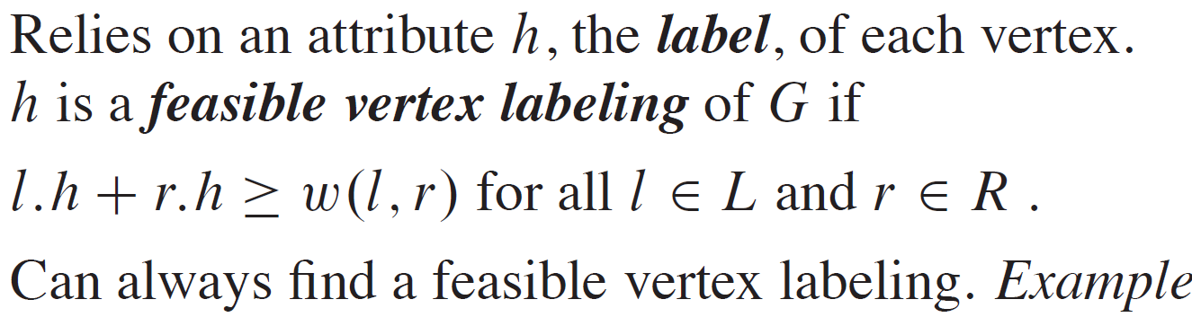
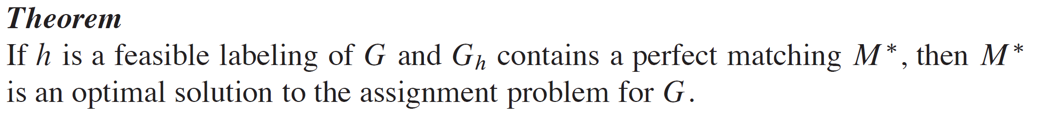
EQUALITY SUBGRAPH (continued)

Slide 32
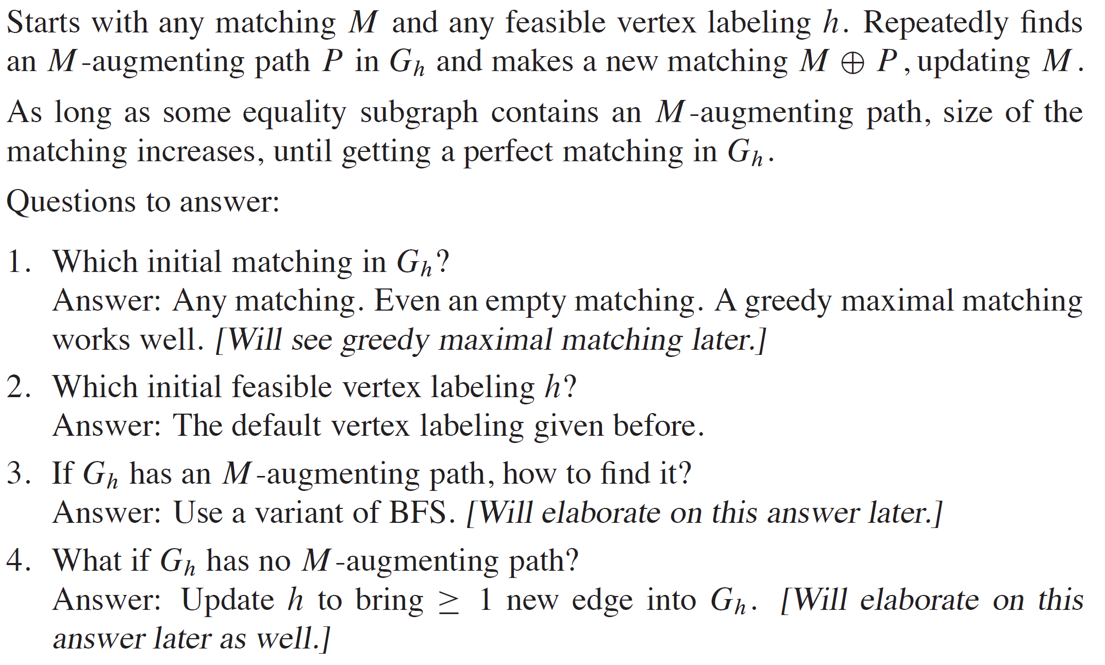
THE HUNGARIAN ALGORITHM
Notes:
Answers:
Any matching. Even an empty matching. A greedy maximal matching works well.
2. The default vertex labeling given before.
Use a variant of BFS.
Update h to bring ≥ 1 new edge into G sub h.

Slide 33
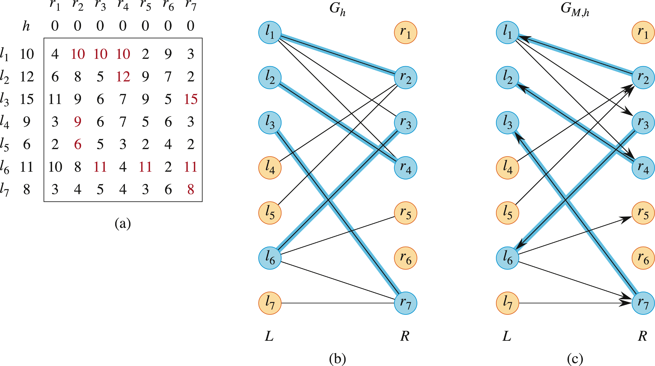
EXAMPLE

Slide 34
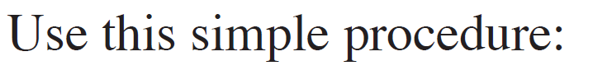
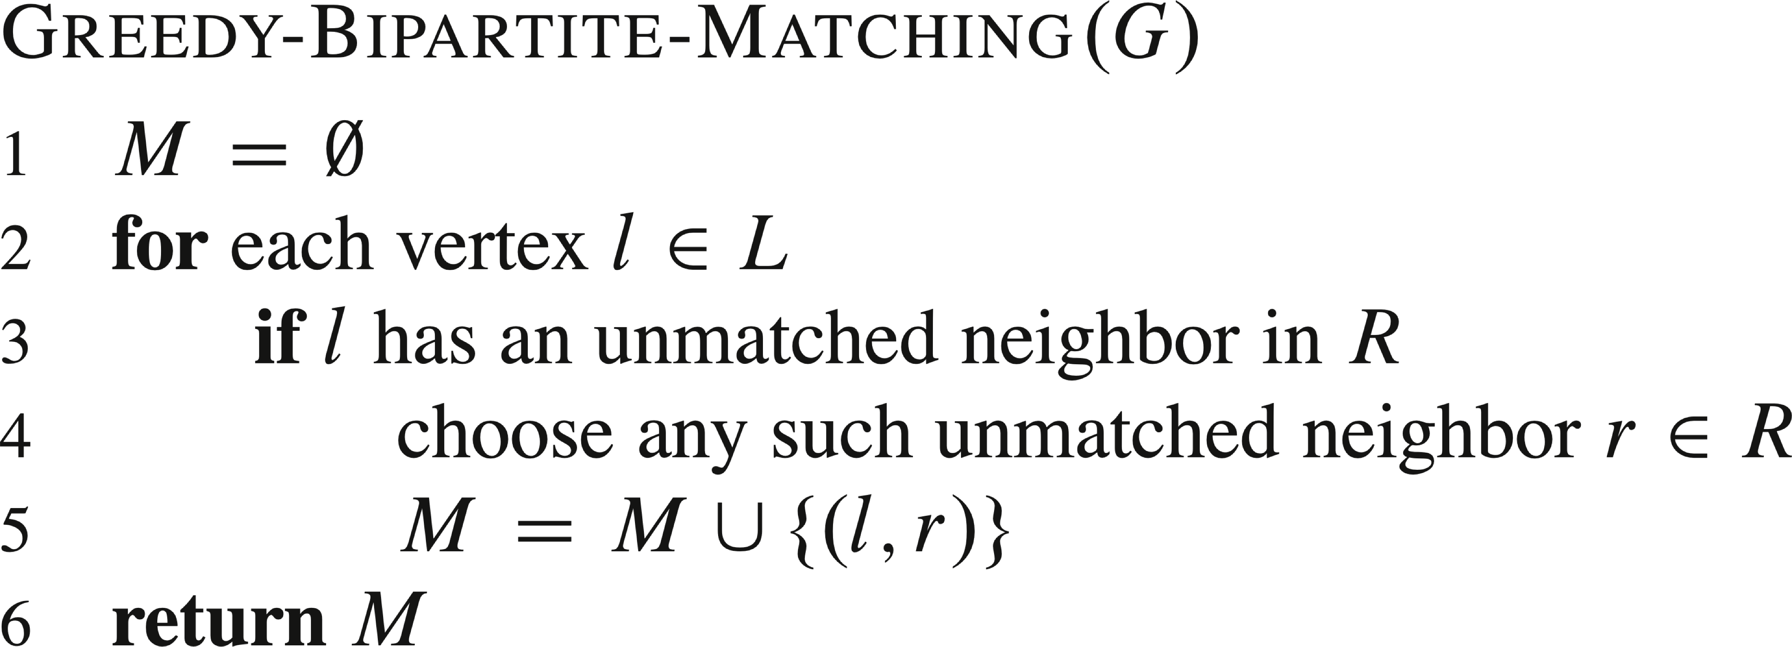
GREEDY MAXIMAL BIPARTITE MATCHING

Slide 35
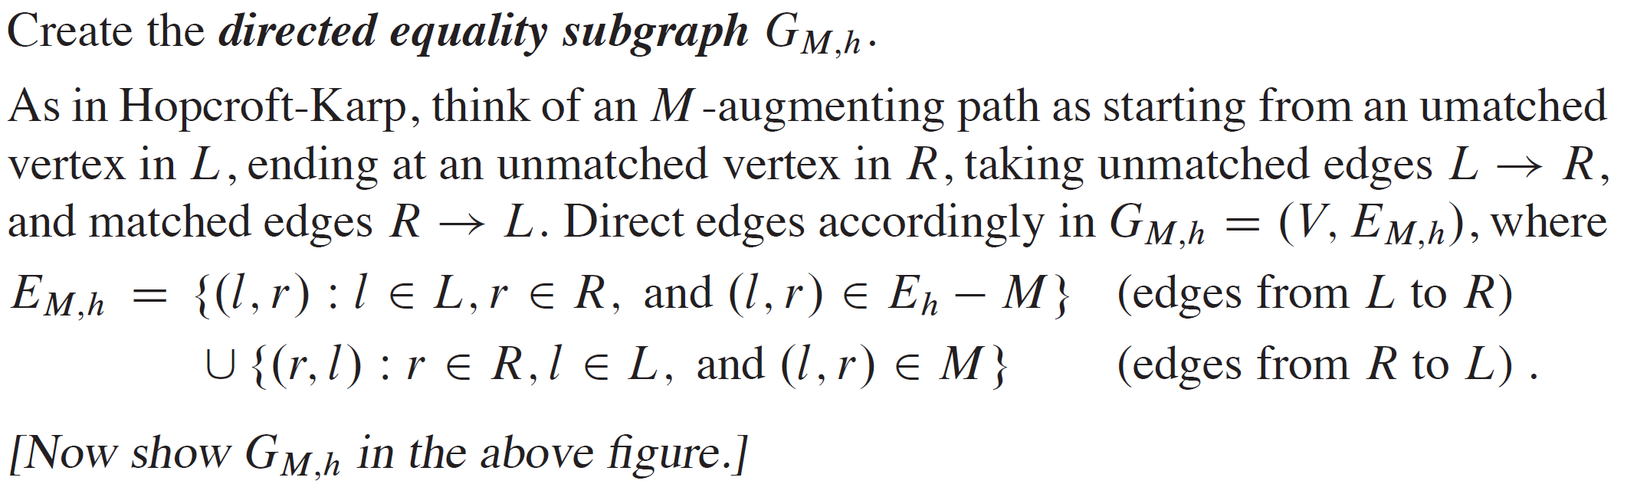
HOW TO FIND AN M-AUGMENTING PATH IN G_{h}

Slide 36
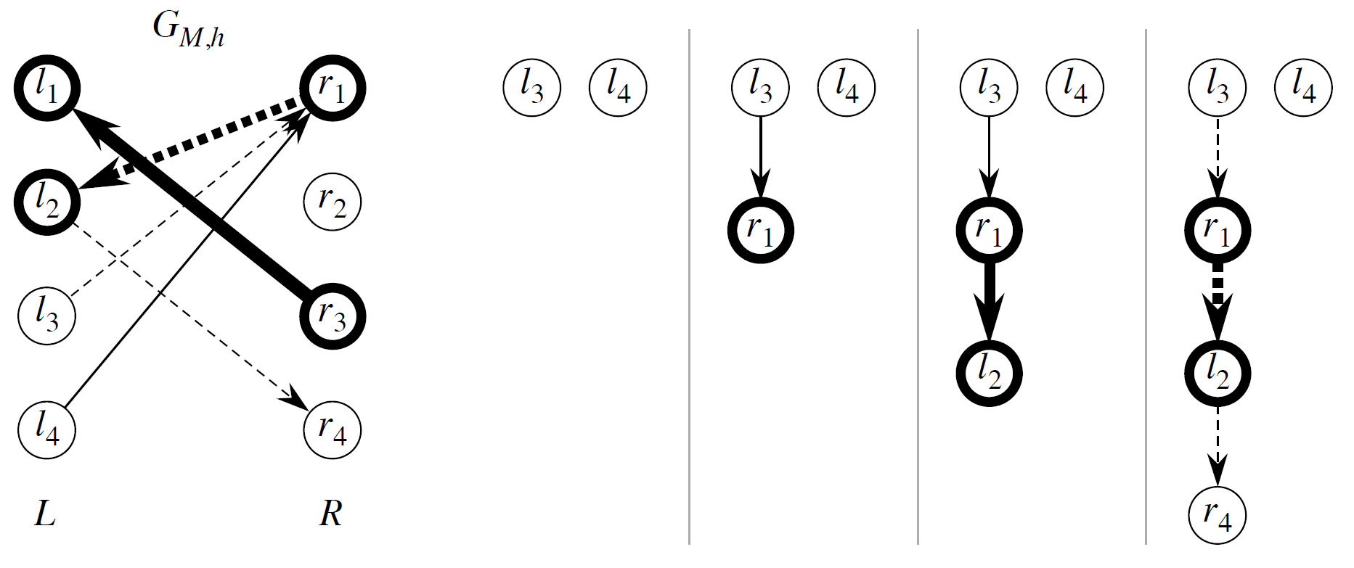
HOW TO FIND AN M-AUGMENTING PATH IN G_{h} (continued)

Slide 37
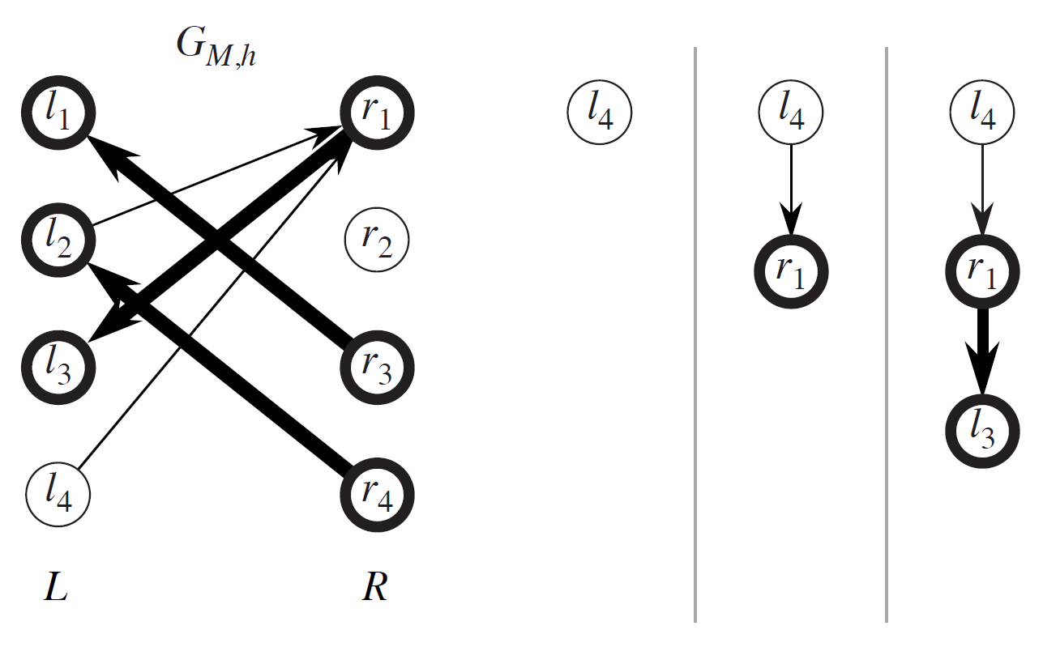
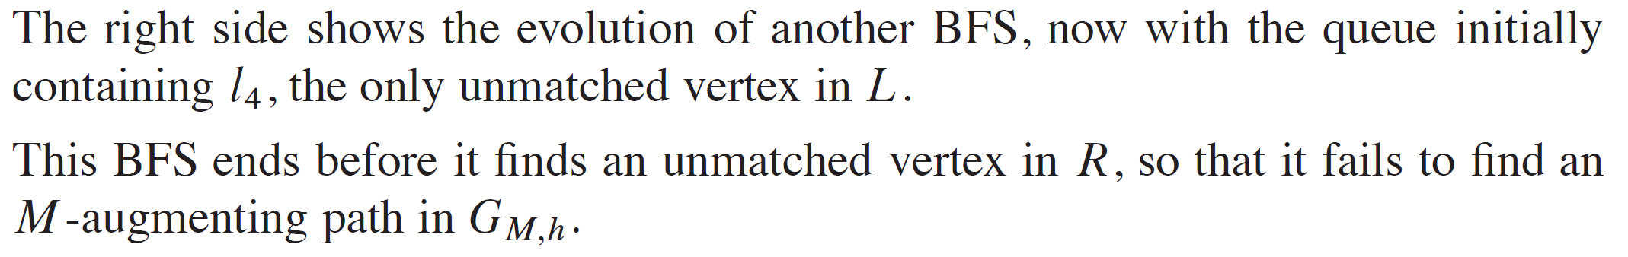
HOW TO FIND AN M-AUGMENTING PATH IN G_{h} (continued)

Slide 38
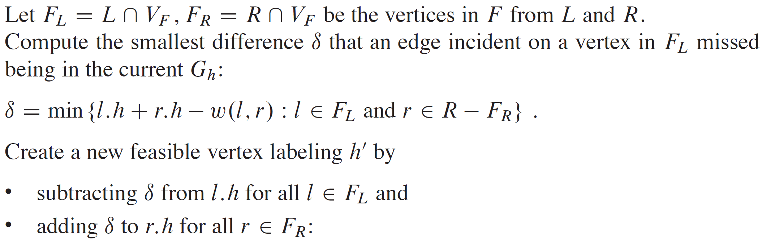
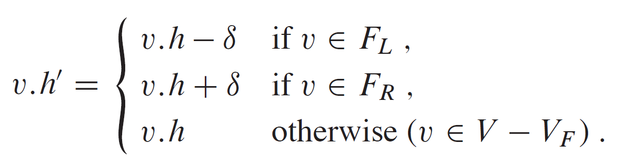
HOW TO UPDATE THE FEASIBLE VERTEX LABELING

Slide 39
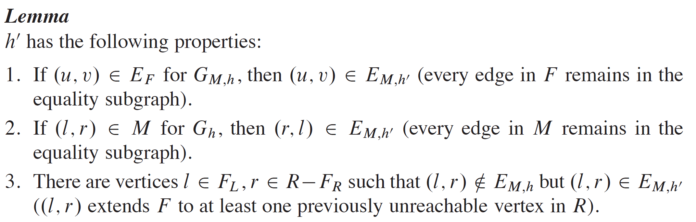
HOW TO UPDATE THE FEASIBLE VERTEX LABELING (continued)

Slide 40

HOW TO UPDATE THE FEASIBLE VERTEX LABELING (continued)

Slide 41

HOW TO UPDATE THE FEASIBLE VERTEX LABELING (continued)

Slide 42


ANALYSIS OF THE HUNGARIAN ALGORITHM

